Slide 1
MVC
MVC stands for Model View and Controller.
It is an architectural design pattern used at the architecture level of an application(MVC is not a programming language, MVC is not a Framework).
Note:
MVC Design Pattern is basically used to develop interactive applications. An interactive application is an application where there is user interaction involved and based on the user interaction some event handling occurred.
MVC is not only used for developing web-based applications but also we can use this MVC design pattern to develop the Desktop or mobile-based application.

Slide 2
MVC
MVC divides an application into 3 major components.
They are Model, View, and Controller.
The main objective of the MVC design pattern is the separation of concerns.
It means the domain model and business logic are separated from the user interface (i.e. view). As a result, maintaining and testing the application becomes simpler and easier.

Slide 3
Model
The Model is the component in the MVC Design pattern which is used to manage that data.
The Model represents a set of classes that are used to describe the application’s validation logic, business logic, and data access logic.
Model contains a set of classes that is used to represent the data and also contains the logic to manage those data.
example, the Student class is the class that is used to represent the data. The StudentRepository class is the class that is used to manage the Student data.

Slide 4
View
The view component in the MVC Design pattern is used represent the model data as a user interface with which the end-user can interact.
view is used to render the domain data (i.e. business data) which is provided to it by the controller.
Views are basically the HTML pages that get rendered into the browser of the client.

Slide 5
Controller
The Controller is the component in an MVC application that is used to handle the incoming HTTP Request.
A Controller is a .cs (for C# language) file which has some methods called Action Methods. When a request comes on the controller, it is the action method of the controller which will handle those requests.
based on the user action, the respective controller will work with the model and view and then sends the response back to the user who initially made the request.
So, it is the one that will interact with both the models and views to control the flow of application execution.
The Controllers are used to manage the overall flow of the application.
Note: In the MVC design pattern both the Controller and View depend on the Model. But the Model never depends on either view or controller. This is one of the main reasons for the separation of concerns. This separation of concerns allows us to build the model and test independently of the visual presentation.

Slide 6
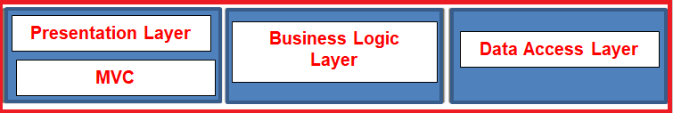
Where MVC is used in the real-time three-layer application?
In general, a real-time application may consist of the following layers
Presentation Layer: This layer is responsible for interacting with the user.
Business Layer: This layer is responsible for implementing the core business logic of the application.
Data Access Layer: This layer is responsible for interacting with the database to perform the CRUD operations.
The MVC design pattern is basically used to implement the Presentation Layer of the application. Please have a look at the following diagram.

Slide 7
ASP.NET Core MVC
The ASP.NET Core MVC is a lightweight, open-source, highly testable presentation framework.
Asp .NET Core MVC is used for building web apps and Web APIs using the Model-View-Controller (MVC) design pattern.
MVC is a design pattern and ASP.NET Core MVC is the framework that is based on MVC Design Pattern.
The ASP.NET Core MVC Framework provides us with a patterns-based way to develop dynamic websites and web apps with a clean separation of concerns.
The ASP.NET Core MVC framework provides us the full control over the mark-up. It also supports for Test-Driven Development and also uses the latest web standards.

Slide 8
ASP.NET Core MVC
The controller is the component in the MVC design pattern, who actually handles the incoming request. In order to handle the request, the controller components do several things are as follows. The controller component creates the model that is required by a view. The model is the component in the MVC design pattern which basically contains classes that are used to store the domain data or you can say business data.
In the MVC design pattern, the Model component also contains the required logic in order to retrieve the data from a database. Once the model created by the controller, then the controller selects a view to render the domain data or model data. While selecting a view, it is also the responsibility of the controller to pass the model data.
In the MVC design pattern, the only responsibility of view is to render the model data. So, in MVC, the view is the component whose responsibility is to generate the necessary HTML in order to render the model data. Once the HTML is generated by the view, then that HTML is then sent to the client over the network, who initially made the request.

Slide 9
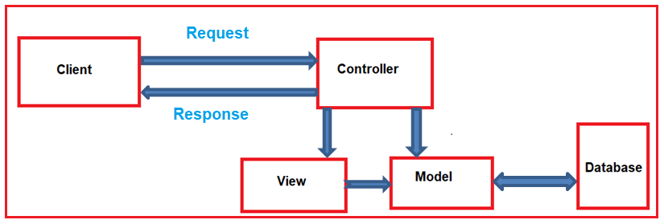
Request Processing in ASP.NET Core MVC

Slide 10
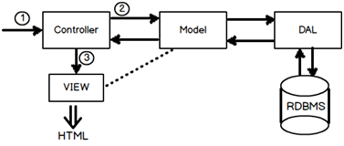
MVC Overview
Asp.Net MVC request flow
Step 1:- The first hit comes to the controller.
Step 2:- Depending on the action controller creates the object of the model. Model in turn calls the data access layer which fetches data in the model.
Step 3:- This data filled model is then passed to the view for display purpose.
when the user enters a URL in the browser, it goes to the server and calls appropriate controller. Then, the Controller uses the appropriate View and Model and creates the response and sends it back to the user.

Slide 11
MVC Flow
Request
Controller
Step 1
Incoming request directed to Controller

Slide 12

MVC Flow
Controller
Model
Step 2
Controller processes request and forms a data Model

Slide 13
MVC Flow
Controller
View
Step 3
Model is passed to View

Slide 14
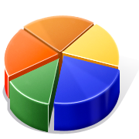
MVC Flow
Controller
View
Step 4
View transforms Model into appropriate output format

Slide 15
MVC Flow
Controller
View
Response
Step 5
Response is rendered

